Slide 1
Real World Data (Including Electronic Health Records) Versus Probability Surveys for Estimating Health Conditions at the State Level Joint Statistical Meetings Portland, Oregon August 7, 2024
Dr. David Marker
Marker Consulting, LLC
MaryandDavidMarker@Gmail.com

Slide 2
The Pressure to use Big Data
Lots of pressure to use administrative sources instead of, or in combination with, probability surveys
Possibly cheaper
Possibly faster
But also possibly less accurate
“It’s no longer enough to conduct surveys and look in the rear-view mirror at what happened. Citizens expect near real-time information…”
Chief Statistician of Canada, Anil Arora, 2022

Slide 3
Outline
Law of Large Populations
Impact of Correlation between response propensity and value being measured
Using Electronic Health Records (EHRs) for state estimates
All of Us
Implications for other EHR providers
This work was largely funded under Contract # W31P4Q-18-D-0002 / W31P4Q-19-F-0584, between CDC and Georgia Tech Research Institute

Slide 4
Collaborators
Rachel Kaufman and Debbie Rolka – CDC
Jon Duke, Charity Hilton, Richard Boyd, and Jacob Zelko – Georgia Tech Research Institute
Will appear in the Journal of Survey Statistics and Methodology

Slide 5
Electronic Health Records (EHRs)
Millions of health measurements on hundreds of thousands of participants
Not nationally-representative, or even state-representative
What are the implications?
We know a 5% random sample is better than a 5% non-random sample. Wu (US Census Bureau) asks:
But is it better than an 80% non-random sample?
A 90% non-random sample?
A 95% non-random sample?
A 99% non-random sample?
Notes:
Typically a collection of health care providers, often in a few parts of a state
Sometimes called Real World Data (RWD) can include doctor records, medicines, claims, etc.
Raise hands, 80% better? Tricky statistical question?

Slide 6
Law of Large Populations (Xiao-Li Meng, 2018)
Accuracy (MSE) of a sample mean is a product of 3 factors
Data Quality: ρ_{R,G} = Corr (R,G)
R is the response propensity
G is the variable being measured
Data Quantity:(1-f)/f = (N-n)/n
Problem Difficulty: σ_{G}
Notes:
Not the Law of Large Numbers (e.g., CLT)
Annals of Applied Statistics
f is the sampling fraction

Slide 7
Law of Large Populations - Implications
Problem Difficulty: σ_{G}
The more variable the data, the less accurate
Data Quantity:
(N-n)/n ≠ (N-n)/N <1
If n=10%N, then (N-n)/n = 9
Data Quality:
ρ_{R,G} ∝ N⁻¹ for probability samples only
Notes:
Data Quantity is not the same as the fpc, which is always <1
Data Quality also known as MNAR or selection bias
For probability samples, the last two terms basically cancel each other out
Taught the press to only focus on problem difficulty

Slide 8
Law of Large Populations – Data Quality
ρ_{R,G} = 0.05 and f = 0.5
n_{eff} = 400
So Big Data with 130,000,000 American adults only as accurate as srs of 400!
ρ_{R,G} = 0.04 and f = 0.5 => n_{eff} = 625
ρ_{R,G} = 0.05 and f = 0.8 (210,000,000) => n_{eff} = 1,600
Notes:
Effective sample size – sample size for which a 95% CI would contain truth 95% of the time. Given expected bias.

Slide 9
Proportion with a COVID-19 Vaccine (Bradley et al., 2021)
3 Web-based sources
Facebook n=250,000
Census Pulse n= 75,000
Axios-Ipsos n= 1,000
Facebook less intensive recruitment
Weighting
All use age and gender
Census and Axios also use race and education
Axios also uses political affiliation and urban/rural
Notes:
CDC provides a benchmark, but it takes longer to produce
Nature

Slide 10
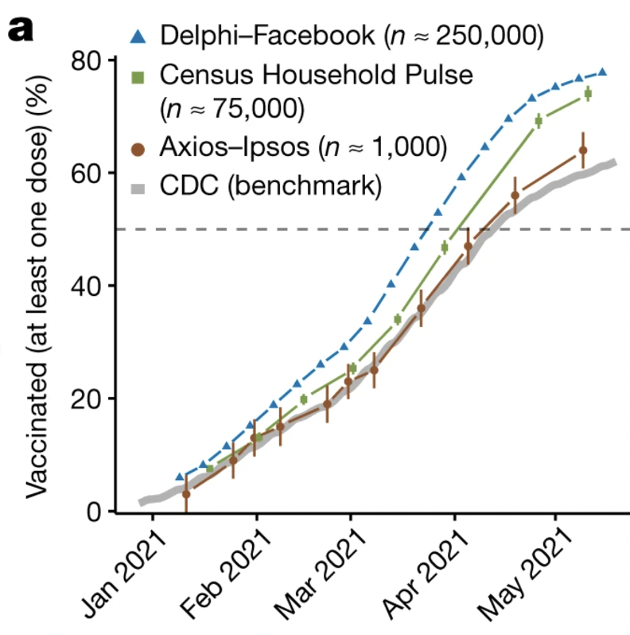
Proportion with a COVID-19 Vaccine
Notes:
A – Facebook and Census sampling errors really small, but Axios closest to truth

Slide 11
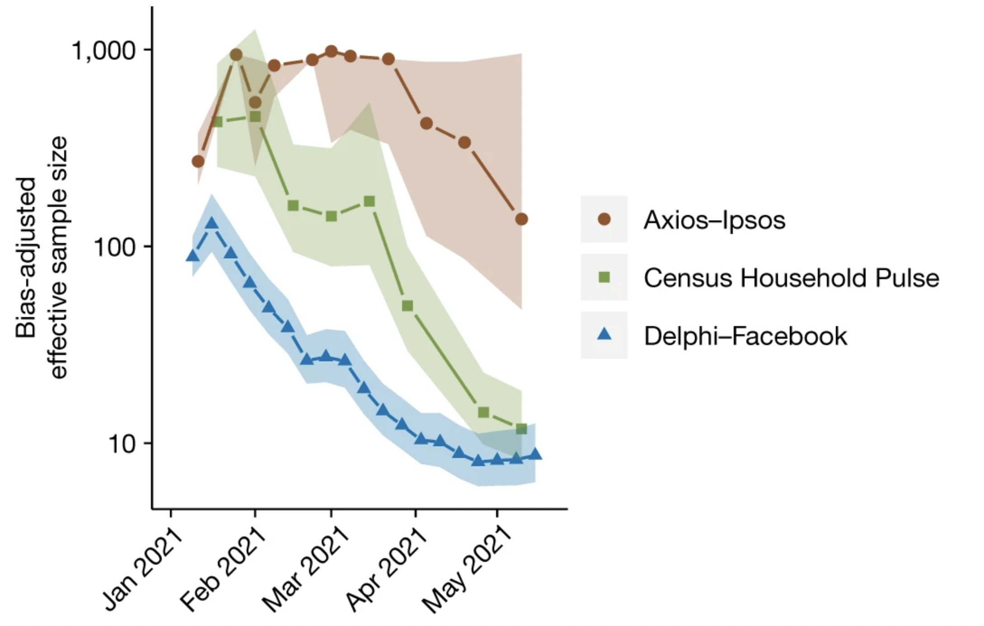
Effective Sample Size for COVID Estimates
n n_{eff}
1,000 200
75,000 15
250,000 10

Slide 12
Remember the Differences in Weighting
 | Facebook | Census Pulse | Axios
Age | X | X | X
Gender | X | X | X
Race |  | X | X
Education |  | X | X
Political Affiliation |  |  | X
Urban/Rural |  |  | X
n 250,000 75,000 1,000 n_{eff} 10 15 200
Notes:
Key is to identify the non-probability impact on the correlation between outcome and participation, and weight accordingly

Slide 13
Can we get Data Quality ρ_{R,G} near 0?
Correlation between participation and outcome must be driven near 0
Weighting can help, if ρ_{R,G} doesn’t start out too big
Do EHR data have correlates of health outcomes such as:
Race
Income
Education
Sex
Health Insurance
Age
Notes:
Weighting - propensity score - multiple regression post-stratification

Slide 14
EHR Data Sources
All EHRs typically have Sex (or Gender) and Age (possibly grouped)
MarketScan, millions of participants, but no race, income, or education.
DartNET has over a million participants’ EHRs, with race missing 9%; no income or education
IQVIA has multiple millions of participants; race missing 13%, <1% Hispanic; no income or education
All of Us

Slide 15

All of Us
Early 2000s the U.S. government planned to collect Big Health data from a nationally-representative sample of 100,000 children, starting with pregnant mothers in their first trimester
Hard and expensive, but definitely doable
NIH cancelled this as it was getting going
The money was redirected and NIH created All of Us
1,000,000 voluntary participants sharing their EHRs
Answering socio-demographic questions including race, income (missing 22%), education, age, and sex (and gender)
Income can be imputed based on education and race
Notes:
Over 300,000 so far; 279,000 with EHR data for at least one visit

Slide 16
Weighting All of Us to Reduce Bias
Raked on 5 dimensions at the State level to American Community Survey (ACS) control totals
Age
Race
Sex/Education
Health Insurance
Income
If a State had <1,000 participants with health visits in All of Us, we used all participants in the Census Division, raked to the State ACS totals
Equivalent to synthetic estimator (NCHS, 1968) using proportions from the Division
This could be improved by incorporating direct responses from the state, but the impact would be minimal here (Marker, 1999)
Notes:
GA Tech developed Python software to identify 2-way interactions causing increased weight variability; selected model to minimize this

Slide 17
All of Us Diabetes Estimates
CDC’s Behavior Risk Factor Surveillance System (BRFSS) collects state-level telephone surveys each year with 2,500+ adults, provides best estimates of diagnosed diabetes at the state level
BRFSS sample is unbiased
Significant nonresponse
Does not adjust for income in its weighting
Can All of Us estimate diabetes at the state level?
Can All of Us estimate diabetes control, unavailable from BRFSS?
SUPREME-DM (Nichols, et al. 2012) definition used by All of Us:
Diagnosis or some medications
At least 2 of: A1c ≥ 6.5% or FPG ≥ 126 mg/dL

Slide 18
Comparing All of Us and BRFSS Diabetes Estimates
Ideally similar patterns, but All of Us should be larger since BRFSS only relies on Diagnosis
Notes:
In general looks good, All of Us estimates are above BRFSS

Slide 19
Comparing All of Us and BRFSS Diabetes Estimates
Ideally similar patterns, but All of Us should be larger since BRFSS only relies on Diagnosis
Louisiana
Only 14% have any
diagnosed condition
Nationally 60%
All others >36%
Inconsistent EHRs
Notes:
Also, those with diabetes more likely to visit doctors and thus be included in EHRs
Understand EHR inconsistencies from state-to-state; may not be useable for some

Slide 20
Comparing All of Us and BRFSS Diabetes Estimates
Ideally similar patterns, but All of Us may be larger since BRFSS only relies on Diagnosis
New England Division
Mostly from MA
Notes:
If EHRs still not representative, poor estimates regardless of size.
For example, MA may have targeted population recruitment at high risk for illness; or focus EHR arrangements for same

Slide 21
Importance of Variables Used in Weighting
Notes:
Clear impact of age, insurance, race, education, and to a lesser extent income.
Not much for sex at birth (Females 16..0%; Males 16.7%)

Slide 22
Importance of Sex-Education Interaction in Weighting
Notes:
Overall trend of higher education associated with lower percent with diabetes;
But much stronger for females. Females from 22.3% to 12.3%; Males from 19.1% to 16.3%

Slide 23
Could we do this for Other EHRs?
IQVIA (and others) have multiple millions of participants;
Race missing 13%, <1% Hispanic
Probably only with health insurance
No income or education
Redo the weighting as if using IQVIA
Only weight based on age and sex

Slide 24
Comparing All of Us and BRFSS Diabetes Estimates
Ideally similar patterns, but All of Us may be larger since BRFSS only relies on Diagnosis
Similar Issues:
New England Division
Louisiana
Lots of changes
31 of 51 >1% change
CT by 9.8%
SC by 5.2%
Less state-to-state variation
Notes:
CT now looks more like MA and rest of New England
Less variability reflected in the estimates

Slide 25
Importance of Variables Used in Weighting (Age and Sex only)
Notes:
Clear impact of age and age-by-sex (male% lower than female% except at 70+
Again not much for sex at birth (Females 16..0%; Males 16.7%)

Slide 26

Importance of Variables Used in Weighting (Age and Sex only)
Notes:
Clear impact of age, insurance, race, education, and to a lesser extent income.
Not much for sex at birth (Females 17.1%; Males 15.0%)

Slide 27

Importance of Variables Used in Weighting (6 marginals)
Notes:
Clear impact of age, insurance, race, education, and to a lesser extent income.
Not much for sex at birth

Slide 28
Proportion With Diabetes by Sex
Weighting on age, insurance, race, income, and sex-by-education
Females 16.0%
Males 16.7%
Weighting on age-by-sex
Females 17.1%
Males 15.0%
Notes:
Are women more likely or less likely to have diabetes? Depends upon what else you control for.

Slide 29
Summary
Big data provide lots of information, but the biases may swamp the reduction in sampling error
If not a probability sample, even small correlation between response propensity and the variable of interest can destroy accuracy of estimates
When using big data, important to minimize such correlation through weighting, propensity score modeling, or other methods

Slide 30
Summary (cont.)
You can produce state-level estimates from EHRs
EHR data may be inconsistent from state to state, so some may be of quite poor quality
EHRs allow for additional estimates at the state level
Simplistic models (based on few socio-economic variables) can produce quite misleading estimates

Slide 31
References
Arora, A. (2022). Modernizing government statistics for the 21st century. Amstat News July 2022.
Bradley, V.C., Kuriwaki, S., Isakov, M., Sejdinovic, D., Meng, X-L., and Flaxman, S. (2021). Unrepresentative big surveys significantly overestimated US vaccine uptake. Nature 600, 695-700.
Fang, M., Wang, D., Coresh, J., and Selvin, E. (2021). Trends in diabetes treatment and control in U.S. adults, 1999-2018. New England Journal of Medicine, 384, 2219-2228. DOI: 10.1056/NEJMsa2032271
Marker, D.A. (1999). Organization of small area estimators using a generalized linear regression framework. Journal of Official Statistics, 15(1), 1-24.

Slide 32
References
Meng, X-L. (2018). Statistical paradises and paradoxes in big data (I): Law of large populations, big data paradox, and the 2016 US Presidential Election. The Annals of Applied Statistics, 12:2, 685-726. DOI: 10.1214/18-AOAS1161SF
National Center for Health Statistics (1968). Synthetic state estimates of disability. P.H.S. Publication No. 1759. Washington D.C.: Government Printing Office.
Nichols, G.A., Desai, J., Lafata, J.E., et al. (2012). Construction of a Multisite DataLink Using Electronic Health Records for the Identification, Surveillance, Prevention, and Management of Diabetes Mellitus: The Supreme-DM Project. Preventing Chronic Disease, Vol 9.
Thank you:
MaryandDavidMarker@Gmail.com

Slide 33
Extra Slides

Slide 34
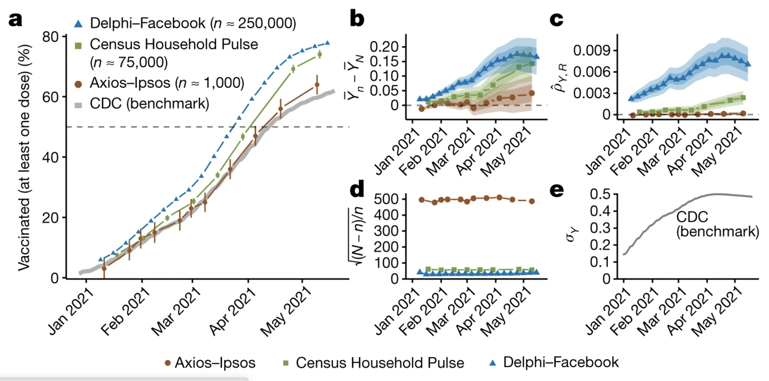
Proportion with a COVID-19 Vaccine
Notes:
A – Facebook and Census sampling errors really small, but Axios closest to truth
B - Total error; shading is if CDC off by 5% and 10%
C – Data Quality: Correlation between vaccine and responding; around 0.006 for Facebook
D – Data Quantity: Big for Axios, but countered by Data Quality
E – Problem Difficulty: Variance largest when proportion is around 50%

Slide 35
Control, Out-of-Control, Indeterminant
Can we use EHRs to provide state estimates of having diabetes under glycemic control?
A1c<7.0
NHANES estimates national control at 50.5% in 2018 (Fang, et al., 2021). No subnational estimates
We can estimate from EHRs for all participants with reported lab data
For those with A1c reported since diagnosis (or other initial incidence), look at most recent A1c – either in control or uncontrolled
Others will have an indeterminant status

Slide 36
Glycemic Control, by State
Notes:
Nice variation, from 61.5% to 32.5%. Extremes coming from divisions with one dominant state (MA and AZ)
CT (and SC and TN) have A1c for almost all participants. WNC doesn’t have A1c for anyone after diagnosis.

